Slide 1
7th Grade Science Semester Exam

Slide 2
Lab Safety and Equipment
Hold a test tube over the Bunsen burner use a test tube holder to prevent you from getting burnt.
Steps for lighting a Bunsen burner
1. Attach hose to gas
2. Check gas and air flow control
3. Turn on the gas
4. Squeeze a flint striker over burner to ignite

Slide 3
Cell Theory
All living things are made up of cells
All cells come from existing cells
All living things take in energy
Cells are the smallest unit of life

Slide 4
Levels of Organization
Remember: CTOSO PCE
Cells
Tissue
Organ
System
Organism
Population
Community
Ecosystem

Slide 5
Prokaryotic vs. Eukaryotic
Prokaryotic
No specialized organelles
No nucleus
Usually Bacteria and Eubacteria
Eukaryotic
Specialized cell organelles (example: Mitochondria)
Nucleus present
Nerve cells, Muscle cells, Bone cells

Slide 6
Animal Cell
Have cell membranes
Small vacuole
Lysosome
Irregular shape

Slide 7
Plant Cell
Cell wall
Chloroplast
Chlorophyll
Rectangular shape
Large central vacuole

Slide 8
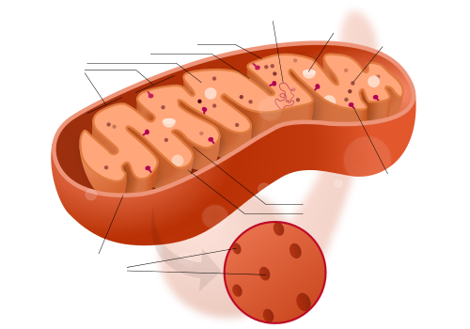
Cell Organelles
Mitochondria – provides energy for the cell
Cell membrane – like a gate regulates the movement of substances into and out of the cell

Slide 9
Organic Compounds
Major element is Carbon (C)
May also contain the following elements Hydrogen (H), Oxygen (O), Nitrogen (N), Phosphorus (P) and Sulfur (S) *CHONPS*
Example C₆H₁₂O₆ Glucose

Slide 10
Asexual Reproduction
Requires only one parent
Identical to parent (cloning)
Faster at reproducing
Types
Fragmentation
Budding
Binary Fission

Slide 11
Sexual Reproduction
Requires two parents
Offspring have traits from both parents
Slower in reproducing

Slide 12
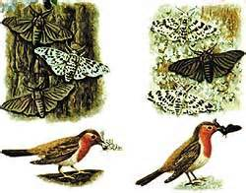
Genetics
Variations in certain species increases survival either through genetics or natural selection

