Slide 1
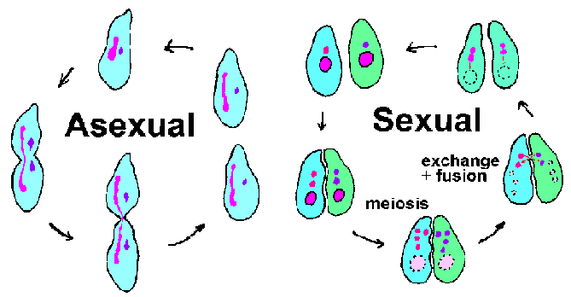
Asexual vs. Sexual Reproduction

Slide 2
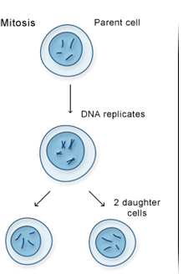
Asexual Reproduction
Requires only one parent
Offspring have 100% the same chromosomes as the parent.
In other words, the offspring are exact “clones” of the parent.
Most unicellular organisms
reproduce this way.
Mitosis
Movie

Slide 3
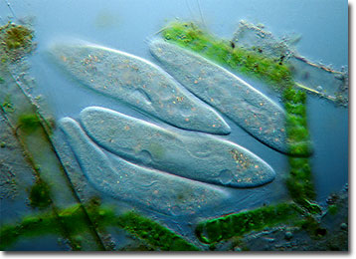
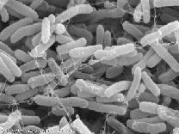
Asexual Reproduction
Binary Fission
Bacteria
Protists
Binary fission is a form of asexual reproduction where every organelle is copied and the organism divides in two.

Slide 4
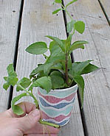
Asexual Reproduction
Plant cuttings
Vegetative reproduction is a type of asexual reproduction in plants that relies on multi-cellular structures formed by the parent plant. It has long been exploited in horticulture and agriculture, with various methods employed to multiply stocks of plants.

Slide 5
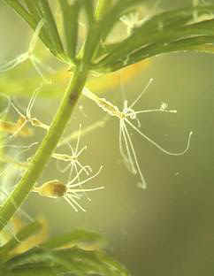
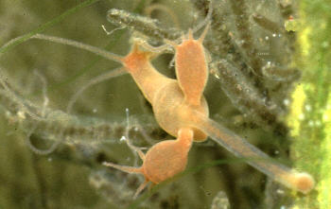
Asexual Reproduction
Budding
Hydra
Movie
Budding is a means of asexual reproduction whereby a new individual develops from an outgrowth of a parent, splits off, and lives independently.

Slide 6
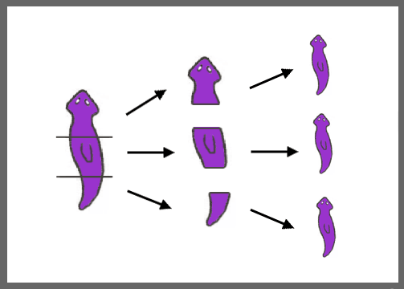
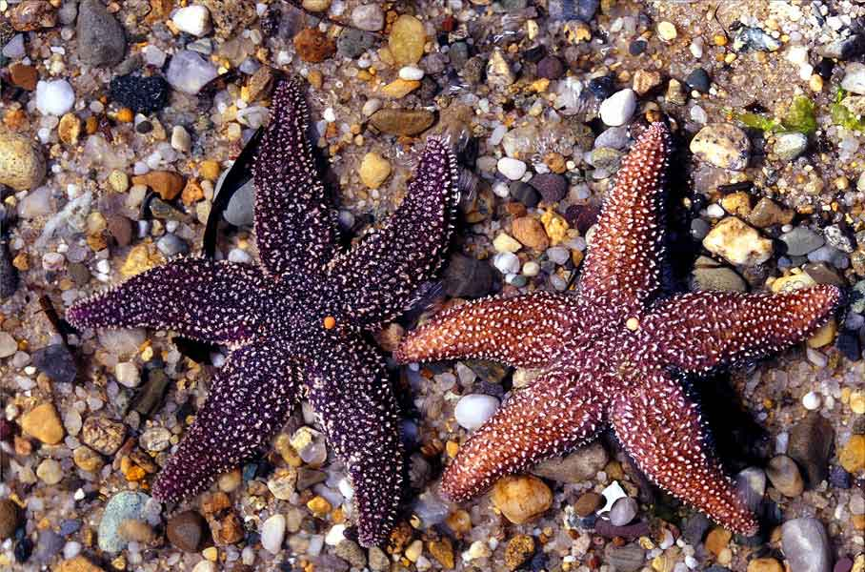
Asexual Reproduction
Fragmentation
Fragmentation is a means of asexual reproduction whereby a single parent breaks into parts that regenerate into whole new individuals.

Slide 7
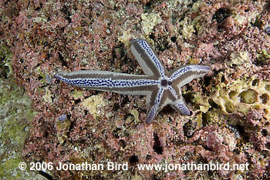
Asexual Reproduction
Regeneration
Regeneration occurs when a body part has broken off and the organism grows a new one.

Slide 8
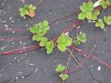
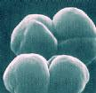
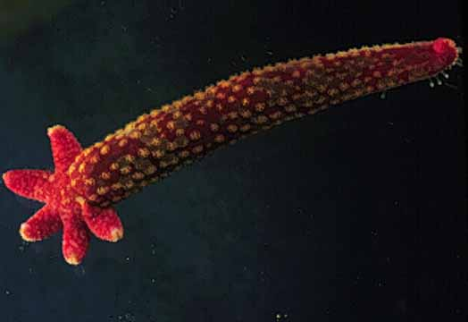
Asexual Reproduction
Examples of organisms that reproduce asexually
Hydra
Sea Star
Strawberry
Archaebacteria
Eubacteria
Euglena
Paramecium
Yeast

Slide 9
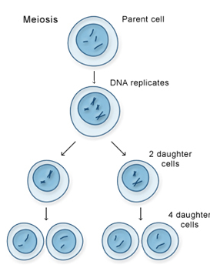
Sexual Reproduction
Requires two parents that each share ½ of the genetic information.
Offspring share the characteristics of each parent.
Meiosis

Slide 10
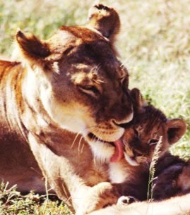
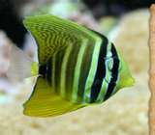
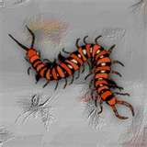
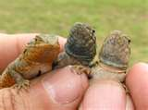
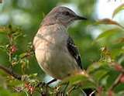
Sexual Reproduction
All the members of the Animal Kingdom
Fish
Mammals
Amphibians
Birds
Reptiles
Insects
Crustaceans

Slide 11
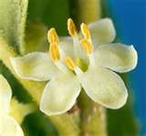
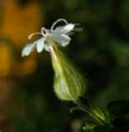
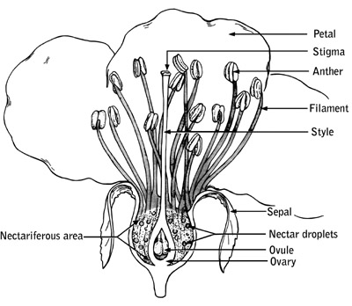
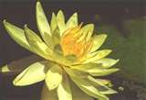
Sexual Reproduction
Plant Kingdom
Flowers are the reproductive organs of plants.
Some flowers have both male and female reproductive organs on the same flower.
Male flower
Female flower

Slide 12
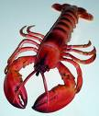
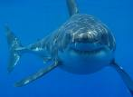
Sexual Reproduction
Examples of organisms that reproduce sexually
Chickens
Iguanas
Lobsters
Sharks
Humans
Butterflies
Sunflowers
Roses

Slide 13
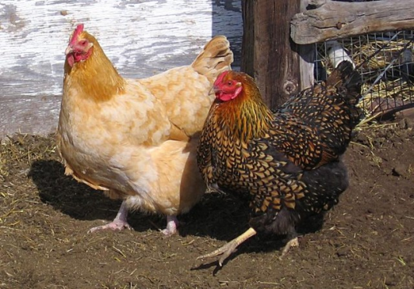
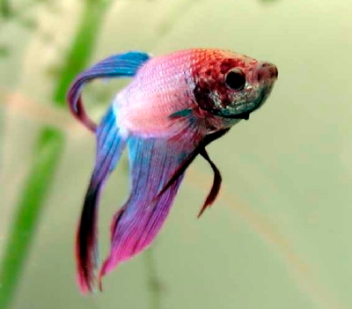
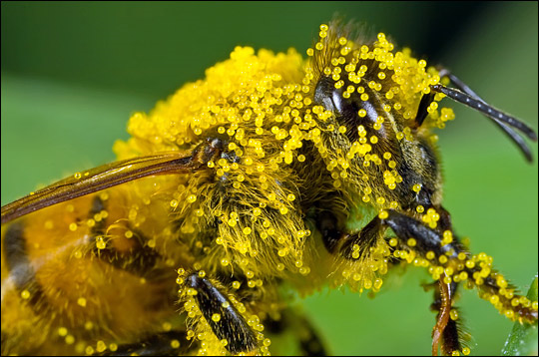
Sexual Reproduction
Happens 2 ways
Internally (inside)
The egg is fertilized by sperm inside the female
Mammals, birds, reptiles, insects, spiders
Externally (outside)
The egg is fertilized by sperm outside the female
The female lays the eggs and then the male fertilizes them.
Fish and some amphibians
Plants and fungi (pollen and spores)

Slide 14
Summarize
Write two paragraphs with 6 sentences each describing asexual and sexual reproduction.
Paragraph 1: Asexual reproduction is…..
Paragraph 2: Sexual reproduction is…

Slide 15
Make a Venn Diagram
Asexual Reproduction
Sexual Reproduction
Both
Types of reproduction in living organisms
Pass DNA from parent to offspring

